Slide 1
WSN@work Peter Van Aken

Slide 2
Topics
Building nodes
Exploring sensors/actuator
Learning RF/electronics
Writing firmware
Configuring controller
Building gateway
Use cases
Demo
Building

Slide 3
Platforms
Arduino (UNO, Nano, Pro mini, Mega…)
ESP8266 (ESP-3/12/…)
Raspberry Pi, BeagleBone black
…

Slide 4
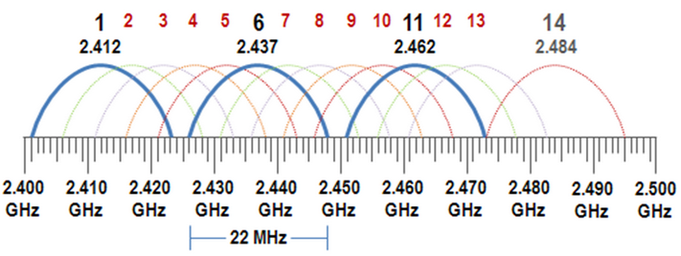

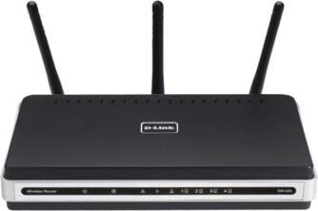
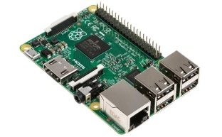
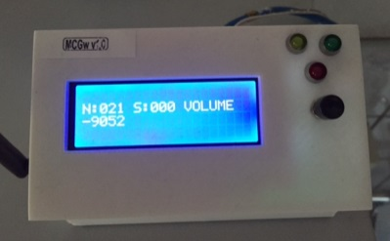


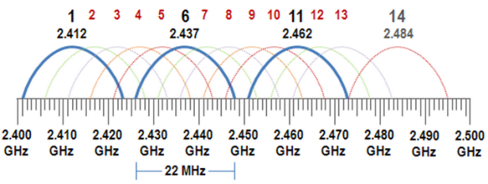
WSN@Work topology
http(s)://192.168.0.107
(wsn / 1234)
Open SSID : WSNatWork
Wifi : auto channel
(192.168.0.1)
LAN
192.168.0.x
Controller
MQTT client Gateway
(192.168.0.225)
Sensor / Actuator node
(192.168.0.107)
Repeater node
ISM (Industrial Scientific Medical) license-free band
Channel 76
selfhealing
meshing
w/battery powered
(2.476Ghz)
Wireless Sensor Network

Slide 5
Learning Arduino ?
USB book stick
Jeremy Blum : “arduino tutorial series” (https://www.youtube.com/watch?v=fCxzA9_kg6s)
Information source : https://www.arduino.cc/
Workshops ☺

Slide 6
ATMEL Atmega328p versus Arduino UNO
Wh at is an “Arduino UNO” :
Cheap open source fast prototyping platform
Based on Atmega328p + USB/serial + power
Arduino IDE
Arduino variants :
Mega, Micro PRO, Nano, … (see boards : Arduino IDE)

Slide 7
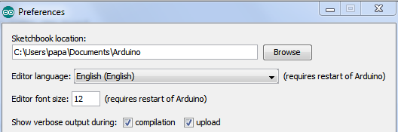
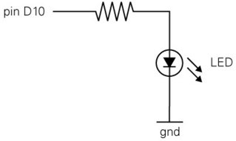
Arduino IDE
Installation :
Windows : https://www.arduino.cc/en/Guide/Windows
MaxOS : https://www.arduino.cc/en/Guide/MacOSX
Linux : http://playground.arduino.cc/Learning/Linux
Examples : “blinking Led”
Connect your LED to pin 2 & change code
2

Slide 8
Arduino IDE alternative
AVR studio

Slide 9
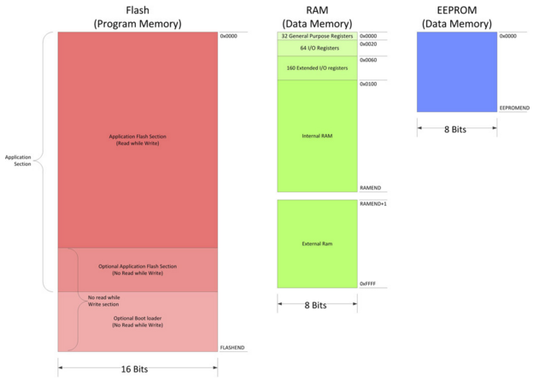
ATMEL Atmega328p
Datasheet : http://www.atmel.com/images/atmel-8271-8-bit-avr-microcontroller-atmega48a-48pa-88a-88pa-168a-168pa-328-328p_datasheet_complete.pdf
Memory map : 32KB flash 2KB RAM 1KB EEprom

Slide 10
Arduino Programming
In system programming (ISP)
Serial bootloader (Optiboot/…)
Note : powered USB hub = extra protection
OTA bootloader
MysBootloader
DualOptiboot

Slide 11
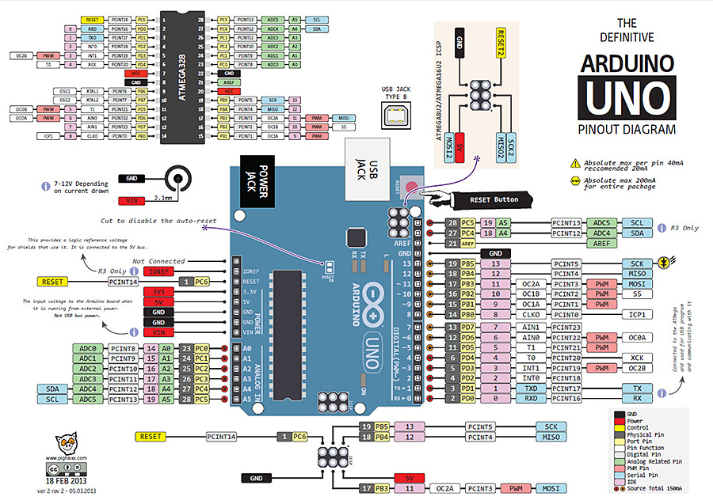
Arduino UNO reference https://arduino-info.wikispaces.com/QuickRef

Slide 12
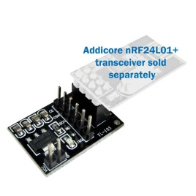
“The Radio” : Nordic NRF24L01+
Datasheet : http://www.nordicsemi.com/eng/Products/2.4GHz-RF/nRF24L01P
Highlights :
2.4Ghz – 2.525Ghz : stay out Wifi band !
250 kbps (only+!), 1Mbps, 2Mbps
Low power : 1.9 – 3.6v, I/Os 5V tolerant
Breakout/adaptor : 3.3v - 12V
Vcc filter capacitor

Slide 13
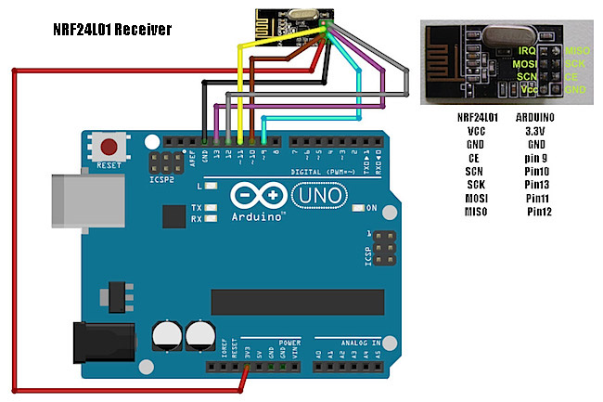
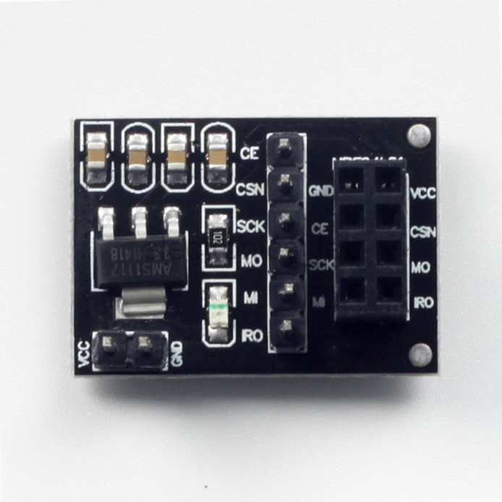
Wiring (SPI interface)

Slide 14
Node firmware : MySensors
http://www.mysensors.org/
Download :
Mysensors v1.5 : http://www.mysensors.org/download/
“node test”
MyConfig.h
Code walk
Change NodeId & go

